Slide 1
Cloud Insights
By
NITHIN S V
MCA S6
TKM19MCA017
Project Guide: Assoc. Prof. Vaheetha Salam

Slide 2
Content
Introduction
Purpose
Features and Functions
Tools and Technology
Methodology
Screenshots

Slide 3
Introduction
Cloud Insights is a platform to monitor and analyze usage cost of cloud platforms in one place. It helps in monitoring and analyze different cloud platform usages in one single application.

Slide 4
Problem Statement
Although cloud services come with a monitoring and analysis dashboard, it lacks the capacity to show the status of several cloud services on the same platform. It's tough to monitor and keep track of each application's usage when you have many accounts on different platforms. This will result in ineffective cost management and resource management.

Slide 5
Purpose
As organization has different accounts in different cloud platforms, it is difficult to monitor the amount of cost utilized by the resource.
Cloud Insights helps in monitor and maintain all the cloud platform accounts in one place.
This will increasing the effective control over the usage of cloud resources.

Slide 6
Features and Functions
Monitor and analyse multiple accounts
Capacity and Resource Planning
Configure thresholds up to resource level
Can add notifications up to resource level
User management

Slide 7
Tools and Technology
Front end
Angular (version 11)
Material Angular
Bootstrap (v4.6)
Backend
Python - Fast API
Database
postgresql

Slide 8
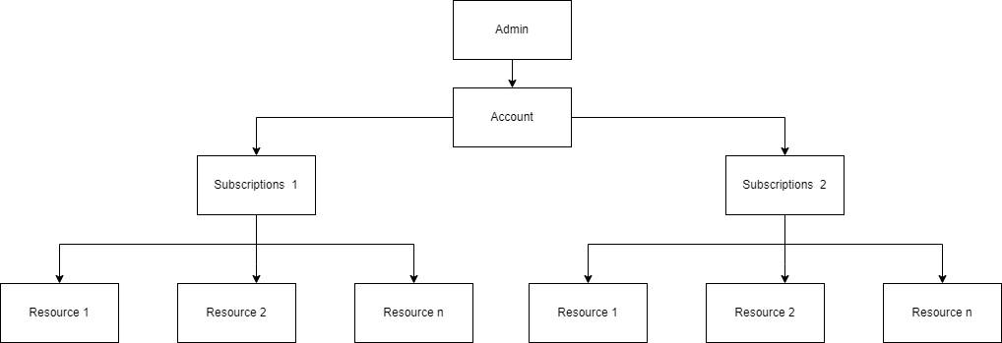
Methodology

Slide 9
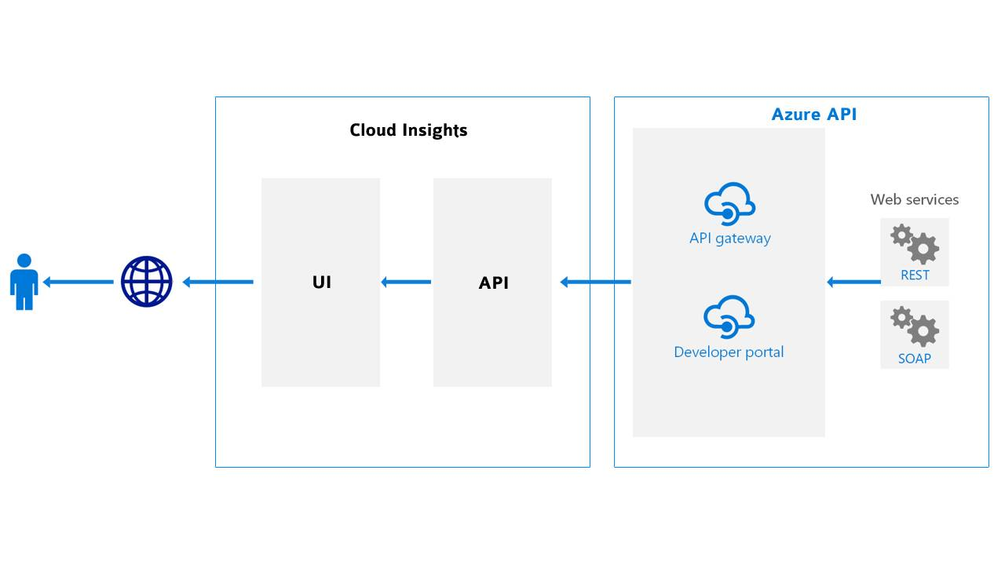

Slide 10
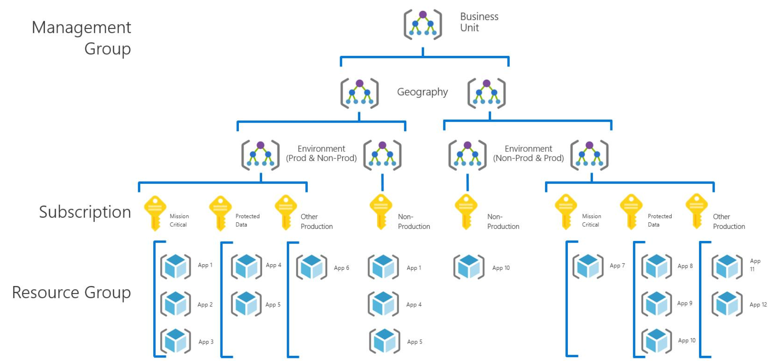

Slide 11
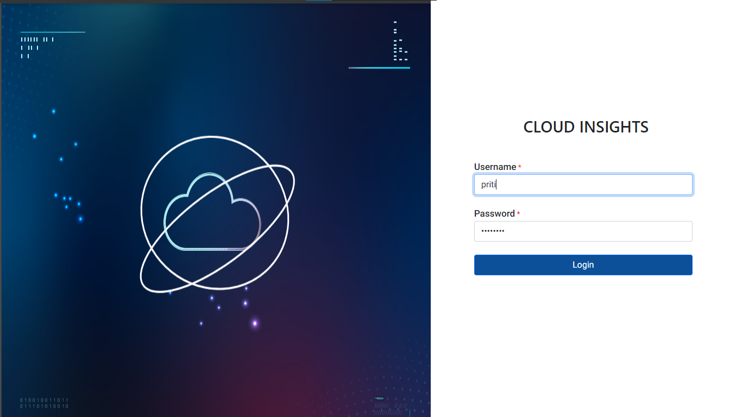
Screenshots

Slide 12
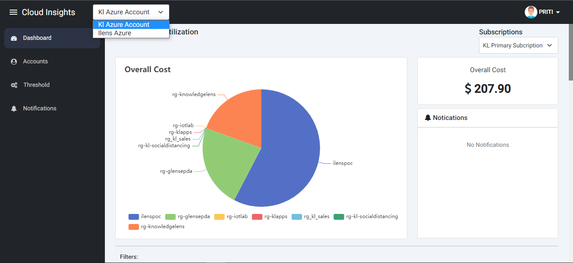

Slide 13
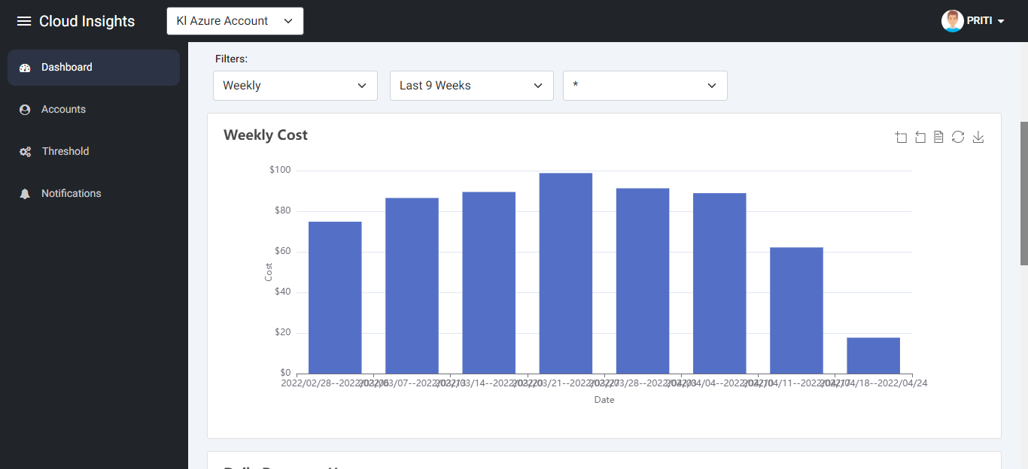

Slide 14
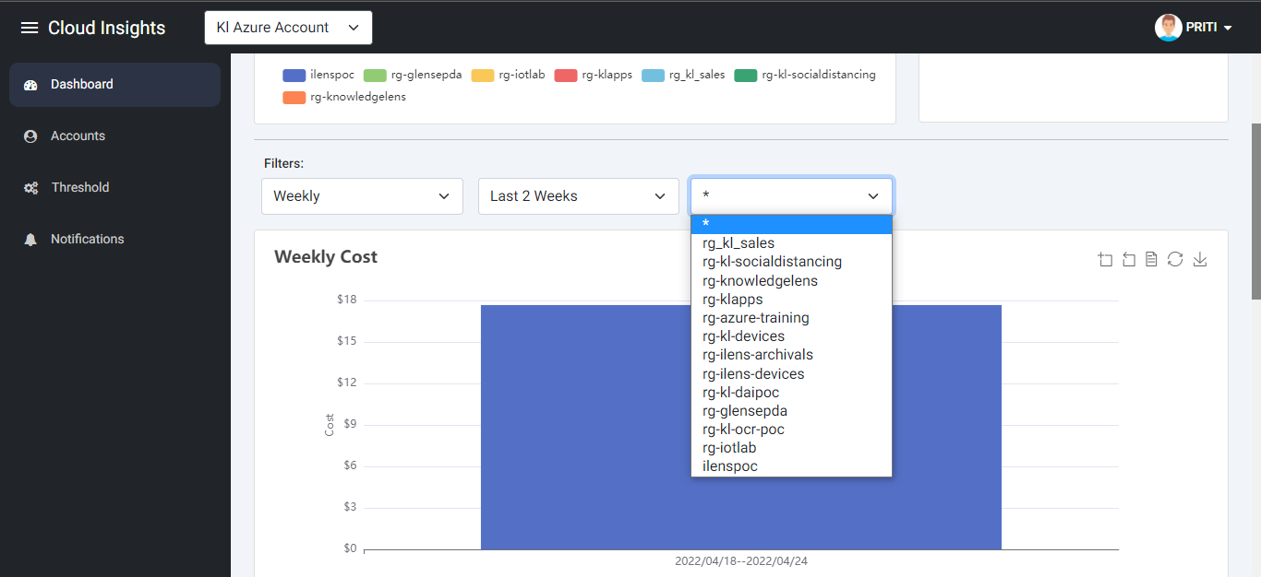

Slide 15
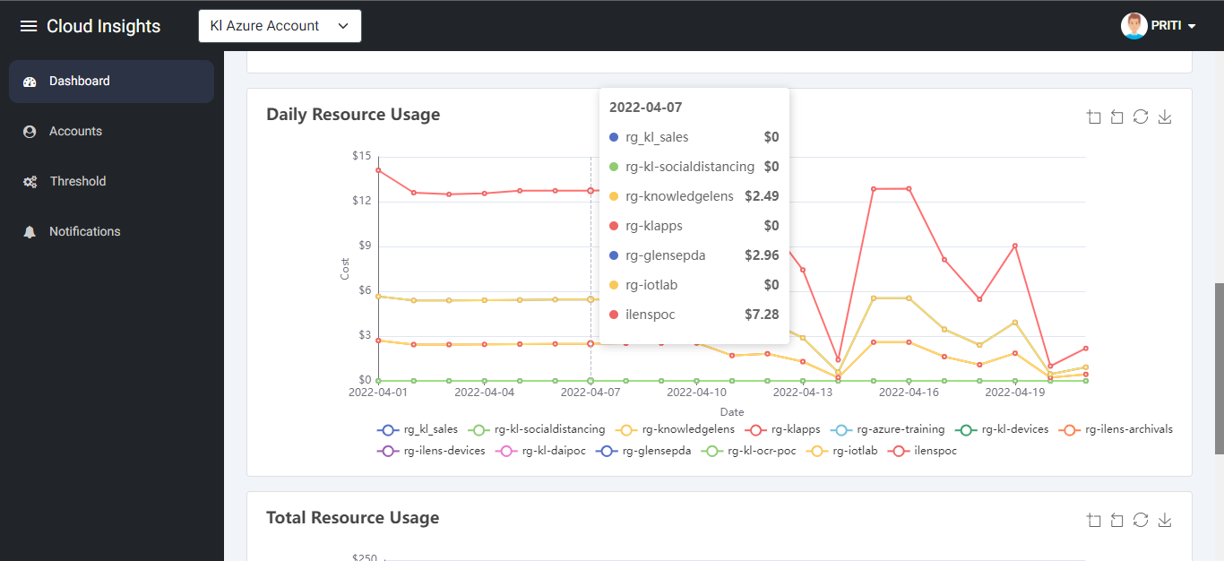

Slide 16
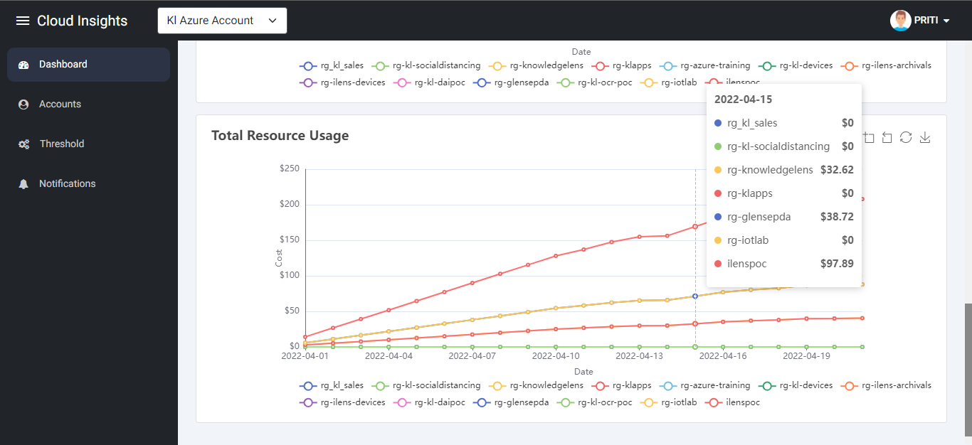

Slide 17
Thank you

